Slide 1
New Features of Java 7 and 8
By: Patrick Fleet, Logan Wright, John Joyce, Ivan Matala

Slide 2
Outline
Java 7:
Underscores in numeric literals
Easier Generic writing
Strings in switch statements
Java 8:
Lambda Expressions
New features for interfaces

Slide 3
Underscores in numeric literals
Java 7 introduced the ability to use underscores in numeric literals
Useful when you want to separate digits

Slide 4
Demo
int debitNumber=1234_5678_1233_1235;

Slide 5
Easier generic writing
Before Java 7, you had to specify which type you wanted twice inside the object instantiation.
i.e: HashMap<Integer, String> hm=new HashMap<Integer, String>();
Starting in Java 7, however, it has been possible to use generics more concisely
i.e: HashMap<Integer, String> hm=new HashMap<>();

Slide 6
Strings in Switch Statements
Before Java 7, to do conditional logic on strings required using if-else statements.
Now, however, it is possible to use switch statements on strings.

Slide 7
Example
System.out.println(“Enter shape”)
String sh=sc.next()
switch (sh)
case “triangle”
System.out.println(“3 sides”)
break;
case “square”
System.out.println(“4 sides”)
break;

Slide 8
Lambda Expressions
Have been in other languages, such as C#, for a long time.
The Java designers were hesitant to add this, but it was finally added in Java 8.
A block of code that you can pass to parameters, without actually creating a method.
These can make programs much more compact and easy to read and understand.
example – (Integer p1, Integer p2) -> { int sum=p1+p2; return sum;}

Slide 9
New Features of Interfaces
Can now contain default methods that don’t need to be implemented
Useful when an interface should provide additional functionality

Slide 10
JavaScript inside Java 8
Nashorn JavaScript engine
Java & JS interoperability

Slide 11



Slide 12
Base64
Encoding
Decoding
Java 8 inbuilt encoder & decoder

Slide 13
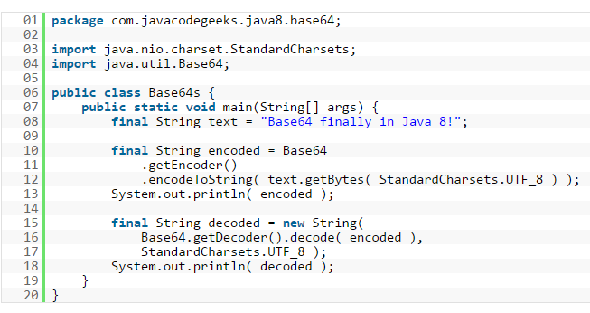

Slide 14


Slide 15
Questions?

Slide 16
THANK YOU

